Slide 1


Optimizing the Selection and Ensembling Process for Machine Learning Models for Resource-Aware Data Stream Management.
Master‘s Theses Kickoff Talk
by Niklas Diller (Computing in the Humanities) on 12.07.2023

Slide 2
Outline
Motivation
Related Work
Approach
Research Question, Hypotheses and Title
Project Plan

Slide 3
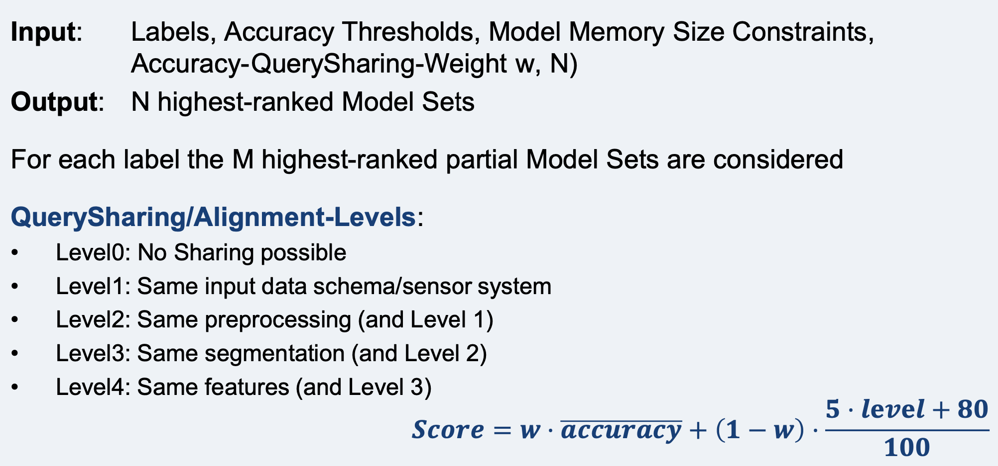
Motivation
Current approach lacks performance but has potential
Notes:
Screenshot of PerCom slides
Decription of Model Set Minder
Has potential for improvisation
1. Until now: Look at output of the different models in a model set and consider, which prediction seems the most likely one -> Highly error prone/not precise/possibly many contradictions between single models
2. Until now: Levels pretty static: A level is either reached or not reached -> Unfair comparison/actual differences in one level are too big.
3. Until now: User can only input treshold/contraint -> Might want to specifically search for models that fulfil certain criteria

Slide 4
Related Work
Process Model: Experimental & Operational Phase (Plan, Build, Test, Deploy, Use, Rebuild)
Retrieval Methods: Forward Stepwise Selection, Bayesian Optimization, Top-K, Score Function,…
Ensembles: Ensemble Selection, Bagging, Stacking, Boosting
Model Management/Model Selection/Model Registry/MLOps
ModelOps Tools: MLFlow, ModelDB, ModelPicker, AutoML, Spark,…
Notes:
Genaue Referenzen/ Literatur hier angeben?
Retrieval Methods: Further research necessary

Slide 5
Approach
How to optimize Model Set Retrieval process?
Ensembles as output to increase overall performance ➔ Implementation of Model Ensembles
Using weights to make more precise calculations for Alignment-Levels ➔ Definition of new Level System
Show only models trained on same farms, sensor systems,… ➔ Adding filters to improve UX
Evaluation by comparing metrics using both versions of the Model Retrieval System
Notes:
1. Until now: Look at output of the different models in a model set and consider, which prediction seems the most likely one -> Highly error prone/not precise/possibly many contradictions between single models
-> Introduce Model Ensembles that give one prediction on the basis of multiple models in the Ensemble (Many different methods for ensembles, will have to settle on one for implementation) Most focus in theses will probably be here.
2. Until now: Levels pretty static: A level is either reached or not reached -> Unfair comparison/actual differences in one level are too big.
-> Work with sub-levels (finer subdivision of levels, but maybe short-sighted) or work with weights: How much % of a level is reached, how much will one level influence the other upcoming levels?
3. Until now: User can only input treshold/contraint -> Might want to specifically search for models that fulfil certain criteria
-> Filter for models that were trained on same farms/cows/sensor systems. Mayabe even filter for certain model algos, but probably not necessary
Evaluation: Accuracy, root-mean-squared error, latency, memory footprint

Slide 6
Research Question and Hypothesis Proposals
How Does Optimizing the Selection and Ensembling Process for Machine Learning Models Support the Resource-Awareness of Machine-Learning-Based Data Stream Processing?
Creating Ensembles Out of a Model Registry Instead of Looking at a Model Set Consisting of Multiple Single Models Increases the Performance of the Classifying Process.
Constructing a Level- and Weight-Based System for Determining the Similarities Between Models Improves the Resource Awareness of the Classifier.
Adding Filters In the Model Retrieval System Helps To Save Resources Without Decreasing the Accuracy of the Classifier.
Notes:
Derived different hypotheses from the approach that can be summarized under one big research question
Especially third hypothesis hard to prove

Slide 7
Title Proposals
Optimizing the Selection and Ensembling Process for Machine Learning Models for Resource-Aware Data Stream Management.
Development of a User-Centered Model Selector and Ensembler (for Classifying Models).
Selecting and Ensembling Machine Learning Models in Regard to Resource-Awareness (in Activity Recognition).
Notes:
Classifying Models to restrictive? But if I need to consider regression, then I would have to consider only certain ensembles, that might be more complicated to implement in my use case

Slide 8
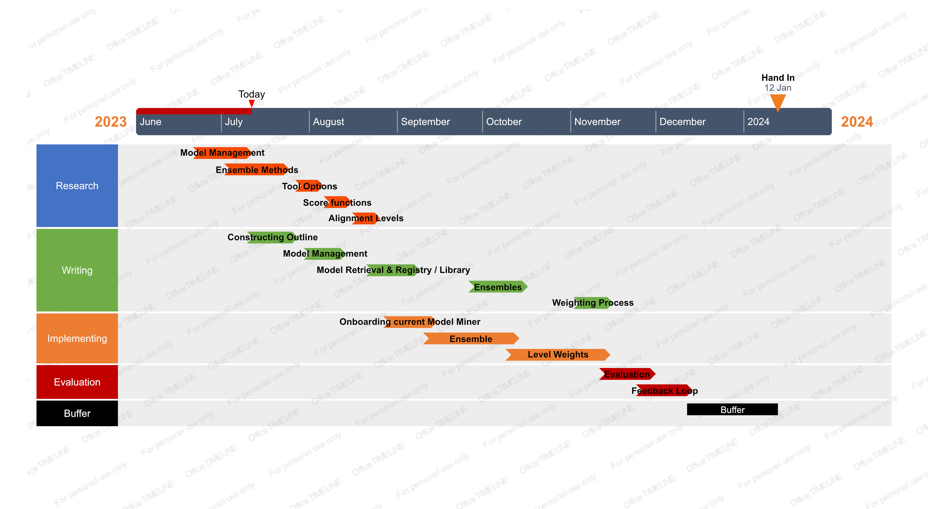
Project Plan

